Slide 1

Data pipelines
Session 4
Sandra Pico Oristrell
December 2023

Slide 2
Agenda
Part 1: Theory (1h, 45 min)
Introduction to Data pipelines
Streaming architectures on AWS
Amazon Kinesis
Two streaming architecture patterns
Batch architectures on AWS
Architecture pattern with AWS Glue
(40 min) Use case: Creating Serverless Batch Architectures – AWS Compute Blogpost
Resources
Break (15 min)
Part 2: Hands-on (1h)
Hands-on Labs (AWS Educate)
Lab 1: Getting Started with Serverless Lab (Lambda Functions)
Lab 2: Builder Lab, Module 7: Multi-step orchestrating with AWS Step Functions

Slide 3
Part 1: Theory

Slide 4
Big Data on AWS
Session 4: Data pipelines
Data Sources
Data Storage
Batch Processing
Analytics Storage
Reporting
Machine Learning
Real-time Ingestion or batch ingestion
Streaming processing

Slide 5
Introduction to Data pipelines

Slide 6
What are data pipelines?
Data pipelines collect, transform, and store data to surface to stakeholders for a variety of data projects.
What is a data pipeline | IBM

Slide 7
What are data pipelines?
A data pipeline is a sequence of data processing steps that move data from one place to another. Data pipelines are used to ingest, transform and deliver data for various purposes, such as analysis , storage or integration.
IBM defines the data pipeline as a method in which raw data is ingested from various data sources and then ported to data store, for analysis. During the flow, the data usually undergoes some data processing.
Data processing steps
Data sources
Destination
Step 1
Step 2
Step N

Slide 8
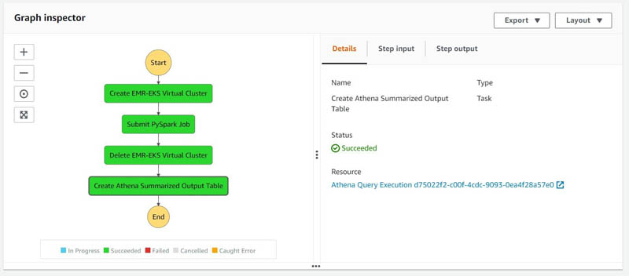

Data pipeline orchestration technology
Most big data solutions consist of repeated data processing operations, encapsulated in workflows. A pipeline orchestrator is a tool that helps to automate these workflows. An orchestrator can schedule jobs, execute workflows and coordinate dependencies among tasks.
AWS Step Functions

Slide 9
Types of data pipelines
There are two main types of data pipelines, which are batch processing pipelines and streaming data pipelines.

Slide 10
Types of data pipelines: Batch
Batch processing pipelines
Batch processing loads batches of data into a repository during set time intervals, which are typically scheduled during off-peak business hours.
Batch processing is usually the optimal data pipeline when there isn’t an immediate need to analyze a specific dataset.
It is associated with ETL (Extract, Transform and Load) data integration process.
Batch processing jobs form a workflow of sequenced commands, where the output of one command becomes the input of the next command. This series of commands will continue until the data is completely transformed and written into data repository.

Slide 11
Types of data pipelines: Streaming
Streaming processing pipelines
Streaming data is leveraged when it is required for data to be continuously updated.
A single action, like a product sale, is considered an event, and related events, such as adding an item to checkout, are typically grouped together as a topic or stream.
Since data events are processed shortly after occurring, streaming processing systems have lower latency than batch systems.

Slide 12
Data pipeline architecture
1
Data ingestion
Data is collected from various sources, with various data structures.
2
Data transformation
Series of jobs are executed to process data into the format required by the destination data repository. These jobs embed automation and governance for repetitive workstreams.
3
Data storage
The transformed data is then stored within a data repository, where it can be exposed to various stakeholders.

Slide 13
Today’s session
1
2
Streaming architectures on AWS
Batch architectures on AWS

Slide 14
Streaming architectures on AWS

Slide 15
Build Modern Data Streaming Architectures on AWS
Organizations need to easily access and analyze all types of data, such as structured, semi-structured, and real-time
streaming data to perform comprehensive and efficient analytics.
They need architectures that enable them to collect, manage, process and analyze all your real-time streaming data in a simple and integration fashion.
Build Modern Data Streaming Architectures on AWS - Whitepaper

Slide 16
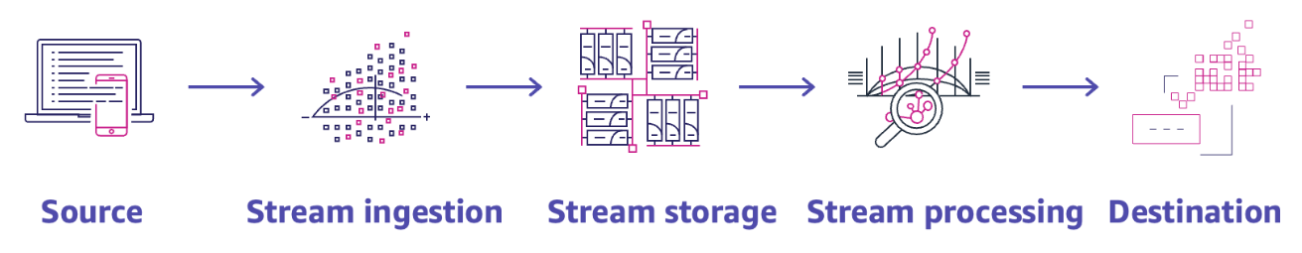
What is a modern data streaming architecture?
AWS defines a modern data streaming architecture as an architecture that allows you to ingest, process, and analyze high volumes of high-velocity data from a variety of sources in real-time to build more reactive and intelligent customer experiences.

Slide 17
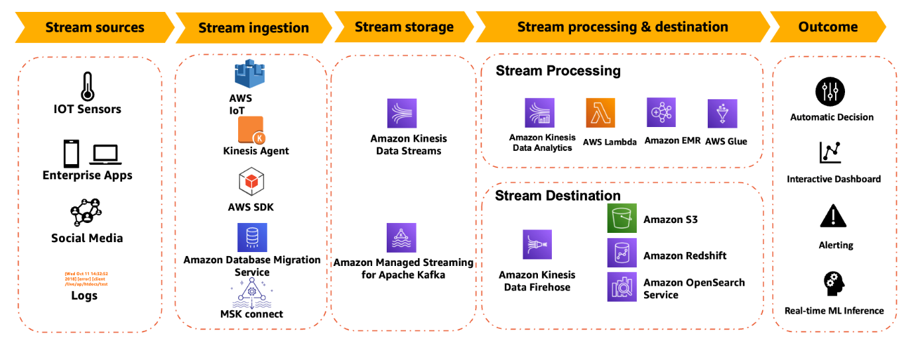
What is a modern data streaming architecture?

Slide 18




Working with streaming data on AWS
Customers want the freedom to move data between their centralized data lakes and the surrounding purpose-built data services in seamless, secure and compliant way.
Streaming data includes a wide variety of data, such as log files, e-commerce purchases, in-game player activity, information from social networks…
AWS provides several options to work with streaming data. You can take advantage of the managed streaming data services offered by Amazon Kinesis, Amazon MSK, Amazon EMR Spark Streaming or deploy and manage your own streaming data solution in the cloud on Amazon Elastic Compute Cloud (Amazon EC2).
Amazon Kinesis
Amazon Managed Streaming for Apache Kafka (Amazon MSK)
Amazon EMR
Amazon Elastic Compute Cloud (Amazon EC2)
Managed streaming data services
Build your own

Slide 19
Amazon Kinesis

Slide 20




Amazon Kinesis
Easily collect, process and analyze data streams in real time
Amazon Kinesis Data Streams
Amazon Kinesis Data Firehose
Amazon Kinesis Video Streams
Amazon Managed Service for Apache Flink
(successor to Kinesis Data Analytics)
Collect and store data streams
for analytics
Load data streams onto AWS data stores and third-party destinations
Collect and store video streams for analytics
Analyze data streams with Kinesis Data Analytics Studio or Apache Flink

Slide 21
Amazon Kinesis
Easily collect, process and analyze data streams in real time
Amazon Kinesis Data Streams
Amazon Kinesis Data Firehose
Amazon Kinesis Video Streams
Amazon Managed Service for Apache Flink
(successor to Kinesis Data Analytics)
Collect and store data streams
for analytics
Load data streams onto AWS data stores and third-party destinations
Collect and store video streams for analytics
Analyze data streams with Kinesis Data Analytics Studio or Apache Flink

Slide 22
Amazon Kinesis Data Streams
Collect, process and analyze real-time streaming data.
Generate timely insights.
Respond in real-time
Amazon Kinesis Data Streams

Slide 23
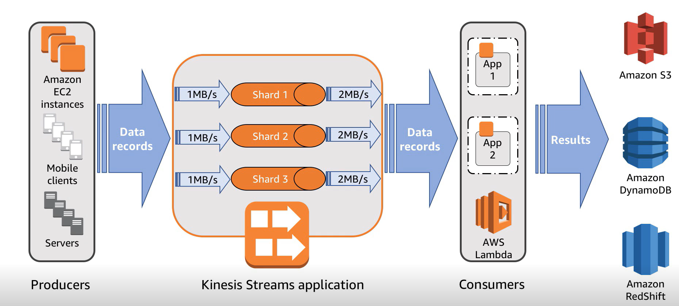
Amazon Kinesis Data Streams
Introduction to Amazon Kinesis Streams

Slide 24
Amazon Kinesis Data Streams
Amazon Kinesis streams enables to:
Preserve client ordering (FIFO method): Client ordering preserves the data and it’s guaranteed to be
received by the consumer in the same order the producer sent the data.
Consume in parallel: You can also consume the same data stream in parallel in multiple Kinesis applications
at one time.
Decouple collection and processing: Kinesis enables you to decouple your collection system (producers),
from your processing system (consumers) and it provides a persistent buffer for your incoming data.

Slide 25

Amazon Kinesis Data Streams and Amazon Kinesis Data Firehose
With Amazon Kinesis Data Firehose:
Reliably load real-time streams into data lakes, warehouses and analytics services.
Easily capture, transform, and load streaming data. Create a delivery stream, select your destination, and
start your real-time data with just a few clicks.
Data sources
Producers
Application (Consumer 1)
Amazon Kinesis Data Streams
Amazon Kinesis Data Firehose
Amazon Simple Storage Service (Amazon S3)

Slide 26
Amazon Kinesis Data Analytics
Amazon Managed Service for Apache Flink
(successor to Kinesis Data Analytics)
Kinesis Analytics reads and processes real-time streaming data

Slide 27

Amazon Kinesis Data Analytics
Step 1
Step 2
Step 3
Amazon Kinesis Data Streams
Amazon Simple Storage Service (Amazon S3)
Kinesis Analytics
SQL editor
Amazon Kinesis Data Firehose
Amazon Redshift
Write your SQL queries to
process data
Configure output stream
destination
Select your input data stream

Slide 28
Streaming architecture patterns

Slide 29
Streaming architecture patterns
Use case examples
Organizations perform streaming analytics to build better customer experiences in near real-time to stay ahead of their competitors because the value of the data diminishes over time. To be near real time, data needs to be produced, captured and processed with low latency.
1
Set up near real-time search on DynamoDB table using Kinesis Data Streams and OpenSearch Service.
2
Build access logs streaming applications using Kinesis Data Firehose

Slide 30
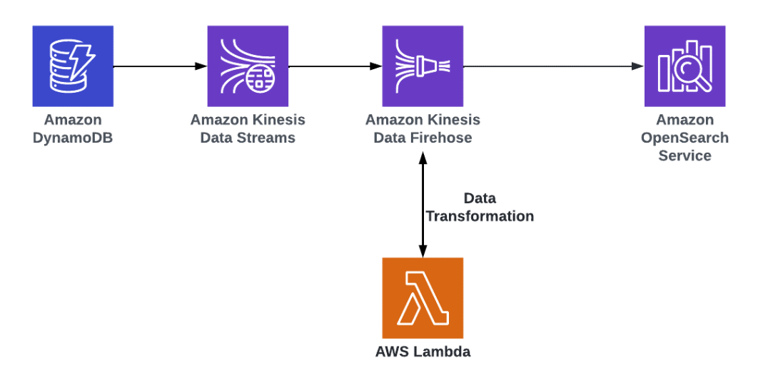
Streaming use case 1
Set up near real-time search on DynamoDB table using Kinesis Data Streams and OpenSearch Service.
Organizations want to build a search service for their customers to find the right product, service, document or answer to their problem as quickly as possible. Their searches will be across both semi-structured and unstructured data (e.g., text), and across different attributes. Search results must be relevant and delivered in near real-time.
AWS Blogpost

Slide 31
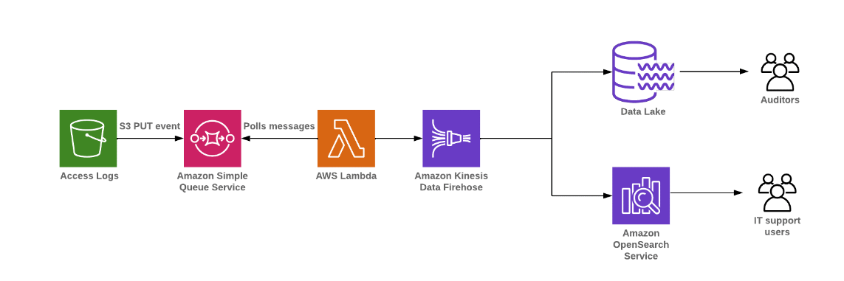
Streaming use case 2
Stream data from diverse data source systems into the data lake using MSK for near real-time reports.
Customers perform log analysis that involves searching, analyzing and visualizing machine data generated by their IT systems and tech infrastructure. It includes logs and metrics such as user transactions, customer behavior, sensor activity…

Slide 32
Streaming other use cases
Additional streaming architecture patterns
Streaming architecture patterns using modern data architectures

Slide 33
Batch architectures on AWS

Slide 34

Batch data processing
Most analytics require frequent batch processing that allows them to process data in batches at varying intervals. As example, processing daily sales aggregations by individual store and then writing that data to the data warehouse on a nightly basis to allow BI reporting to run queries faster.
On AWS, analytic services such as Amazon EMR, Amazon Redshift, Lake Formation Blueprints and AWS Glue allow you to run batch data processing jobs at scale for all batch data processing use cases and for various personas.
AWS Glue
Amazon EMR
Hadoop y Spark: diferencia entre los marcos de Apache. AWS (amazon.com)

Slide 35
Characteristics
Ease of use development framework
Support disparate source and target systems
Support various data file formats
Seamlessly scale out to process peak data volumes
Simplified job orchestration with job bookmarking capability
Ability to monitor and alert on job failure
Provide a low-cost solution

Slide 36
Batch data processing
Comparison between Amazon EMR and AWS Glue
As part of the big data processing portfolio, AWS has two main services that allow you to perform ETL (Extract, Transform, and Load) workloads: AWS Glue and Amazon EMR (Elastic MapReduce). Both tools provide ETL processing capabilities, which one you choose will be highly dependent on your current infrastructure.

Slide 37
Batch data processing
Comparison between Amazon EMR and AWS Glue
AWS Glue is a serverless data integration service that aims to help users discover data across data sources,
Prepare the formats and schemas and combine and process data. AWS Glue works with multiple databases, data warehouses and data lakes sources. It also provides different visualization tools to define the ETL workloads.
AWS Glue
Amazon Elastic MapReduce (EMR) is a big data platform. It supports data streaming workloads via Apache Spark. You can also use EMR Studio to build data pipelines, visualize data flow and execute SQL queries.
Amazon EMR

Slide 38
Batch data processing
Comparison between Amazon EMR and AWS Glue
1
Serverless vs Managed Services
AWS Glue is a serverless data integration platform that handles infrastructure, configuration options and setup. Amazon EMR also has a serverless option. AWS Glue is suited to simpler data ETL workflows with Spark.
Amazon EMR is mostly a managed service for self-configured infrastructures, such as Amazon EC2 instances. EMR supports Apache Hadoop ecosystem components and Apache Spark… Amazon EMR is a more comprehensive data operations managed service platform.

Slide 39
Batch data processing
Comparison between Amazon EMR and AWS Glue
2
Expenses, Operating Costs and Pricing
Add service - AWS Pricing Calculator

Slide 40
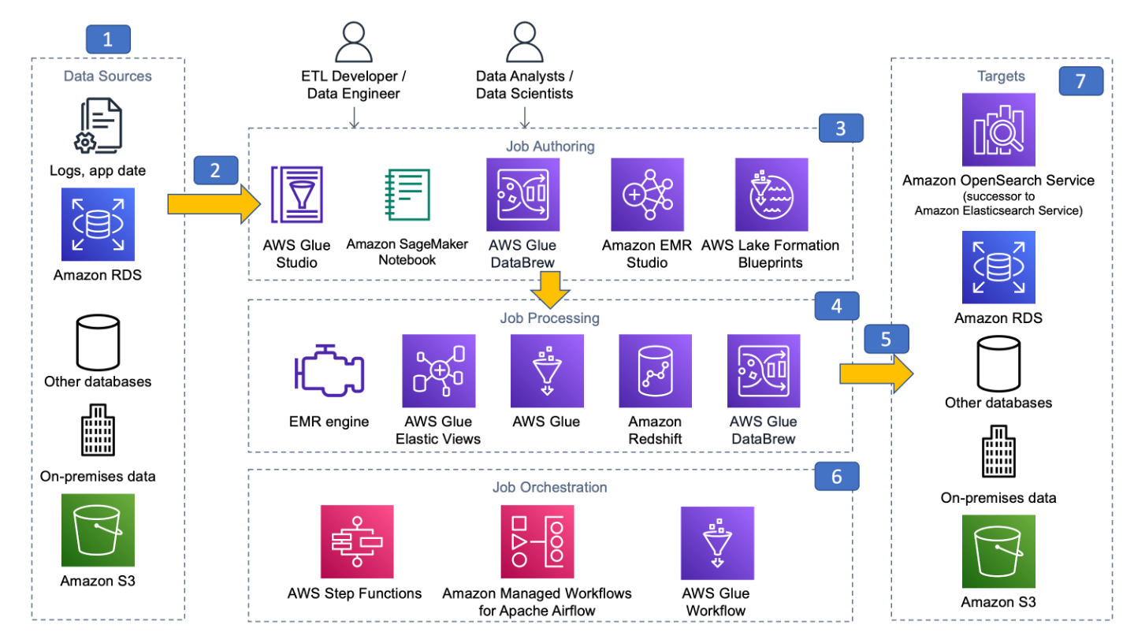
Reference architecture
Reference architecture - Data Analytics Lens (amazon.com)

Slide 41
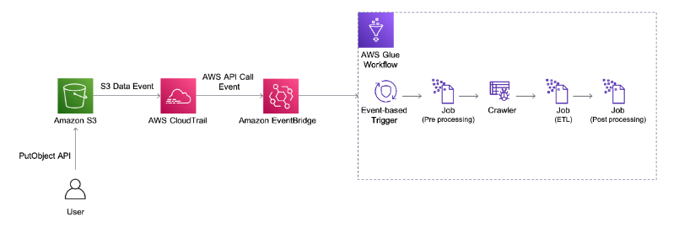
Architecture pattern with AWS Glue
Build a serverless event-driven workflow with AWS Glue and Amazon EventBridge | AWS Big Data Blog

Slide 42
Use case

Slide 43

Serverless batch architectures
AWS Compute Blog
Creating AWS Serverless batch processing architectures | AWS Compute Blog (amazon.com)
Reading time
30 min
Discussion time
10 min

Slide 44
Resources

Slide 45
Resources
The content of this section was based on the following resources:
What is a data pipeline | IBM
Working with streaming data on AWS - Build Modern Data Streaming Architectures on AWS (amazon.com)
https://aws.amazon.com/blogs/compute/creating-aws-serverless-batch-processing-architectures/
AWS Data Analytics Well Architecture Framework
Further resources that can be useful to continue learning:
AWS Glue Workshops
Amazon EMR Workshops

Slide 46
Part 2: Hands-on

Slide 47
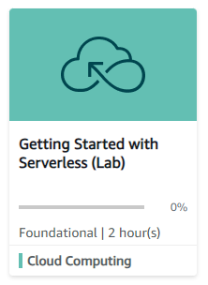
Hands-on Labs
AWS Educate Labs
1
Getting Started with Serverless (Lab)
Link
Getting Started with Serverless (instructure.com)
Lab duration
~ 45min
Description
In this lab, you create and configure an AWS Lambda function to be initiated when an image is uploaded to an Amazon Simple Storage Service (Amazon S3) bucket. You review the related logs to determine how the function is performing. You modify the function configuration to optimize the performance.

Slide 48
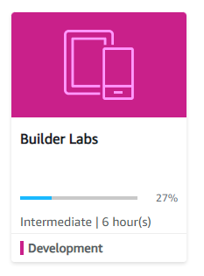
Hands-on Labs
AWS Educate Labs
2
Builder Labs: Module 7 – AWS Step Functions Lab
Link
Builder Lab - Module 7: AWS Step Functions (instructure.com)
Lab duration
~ 1hour
Description
Orchestrating multi-step processes with AWS Step Functions: In this lab, you will use AWS Step Functions to coordinate the actions necessary to generate and deliver a report upon request. The report will contain data from a database.

Slide 49
Thank you

